Slide 1
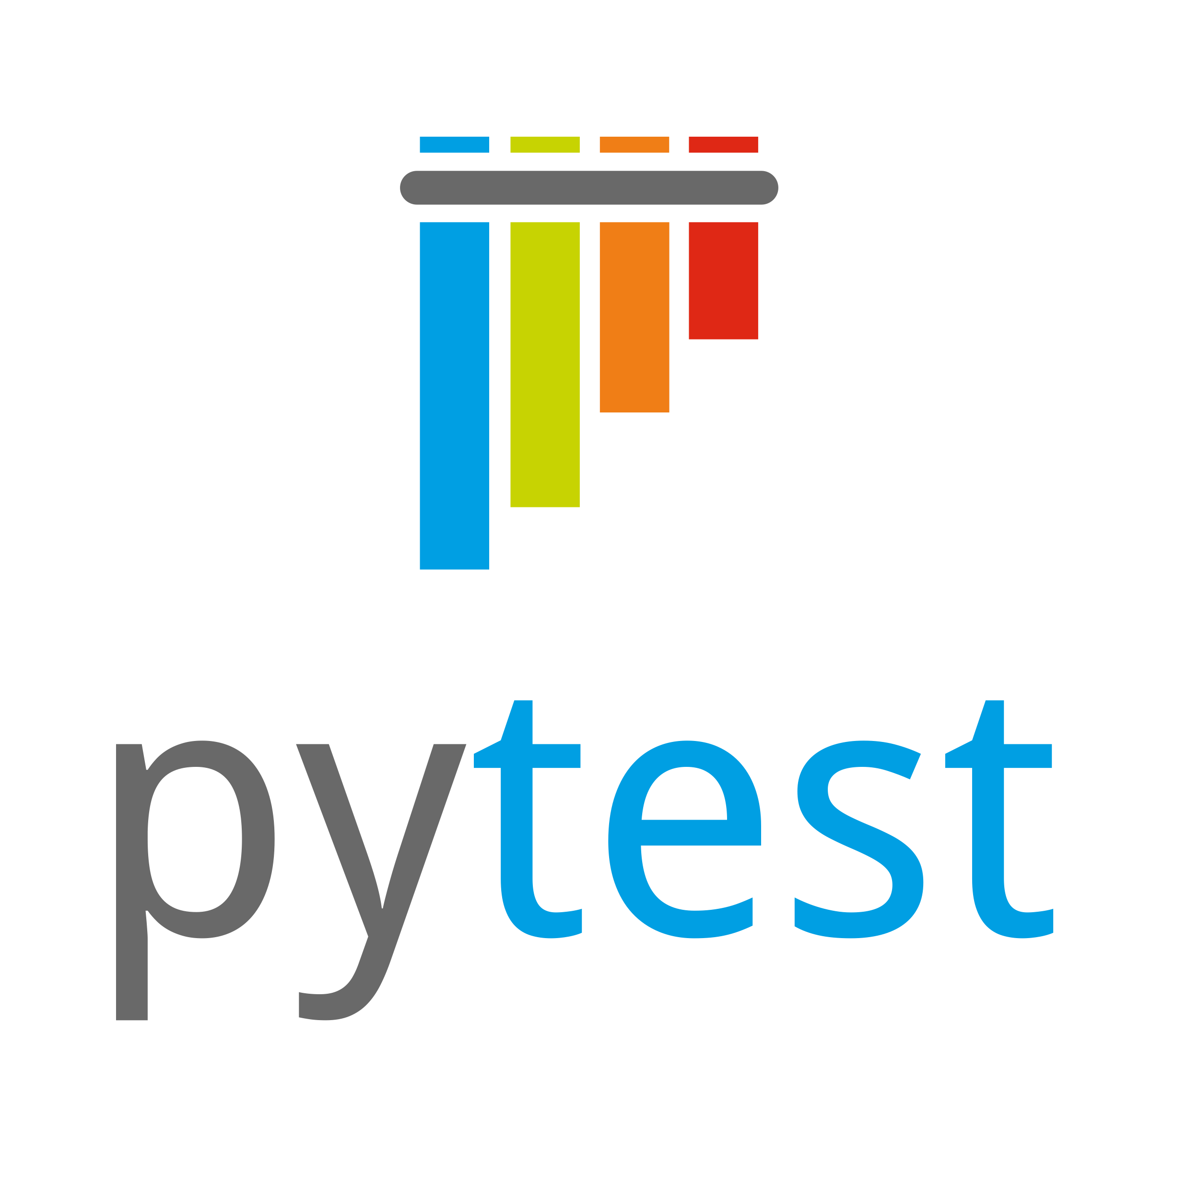
Testing with Pytest
Michigan Python
fosstodon.org/@danyeaw

Slide 2
Why Test?
The aim is Built-in Quality
Confidence in the original code
Ability to refactor and make improvements
Improved collaboration
Workflow automation
More frequent delivery
Faster customer feedback

Slide 3
Test Driven Development (TDD)
Write
Write a Test
Run
Run All Test and Observe Failures
Write
Write Code to Pass Tests
Run
Run all Tests and Observe Pass
Refactor
Refactor as Necessary

Slide 4
Why Pytest
Less Boilerplate
Nicer Output
Less to Learn
Easy to Filter Tests
Test Parameterization
Powerful Plugins

Slide 5
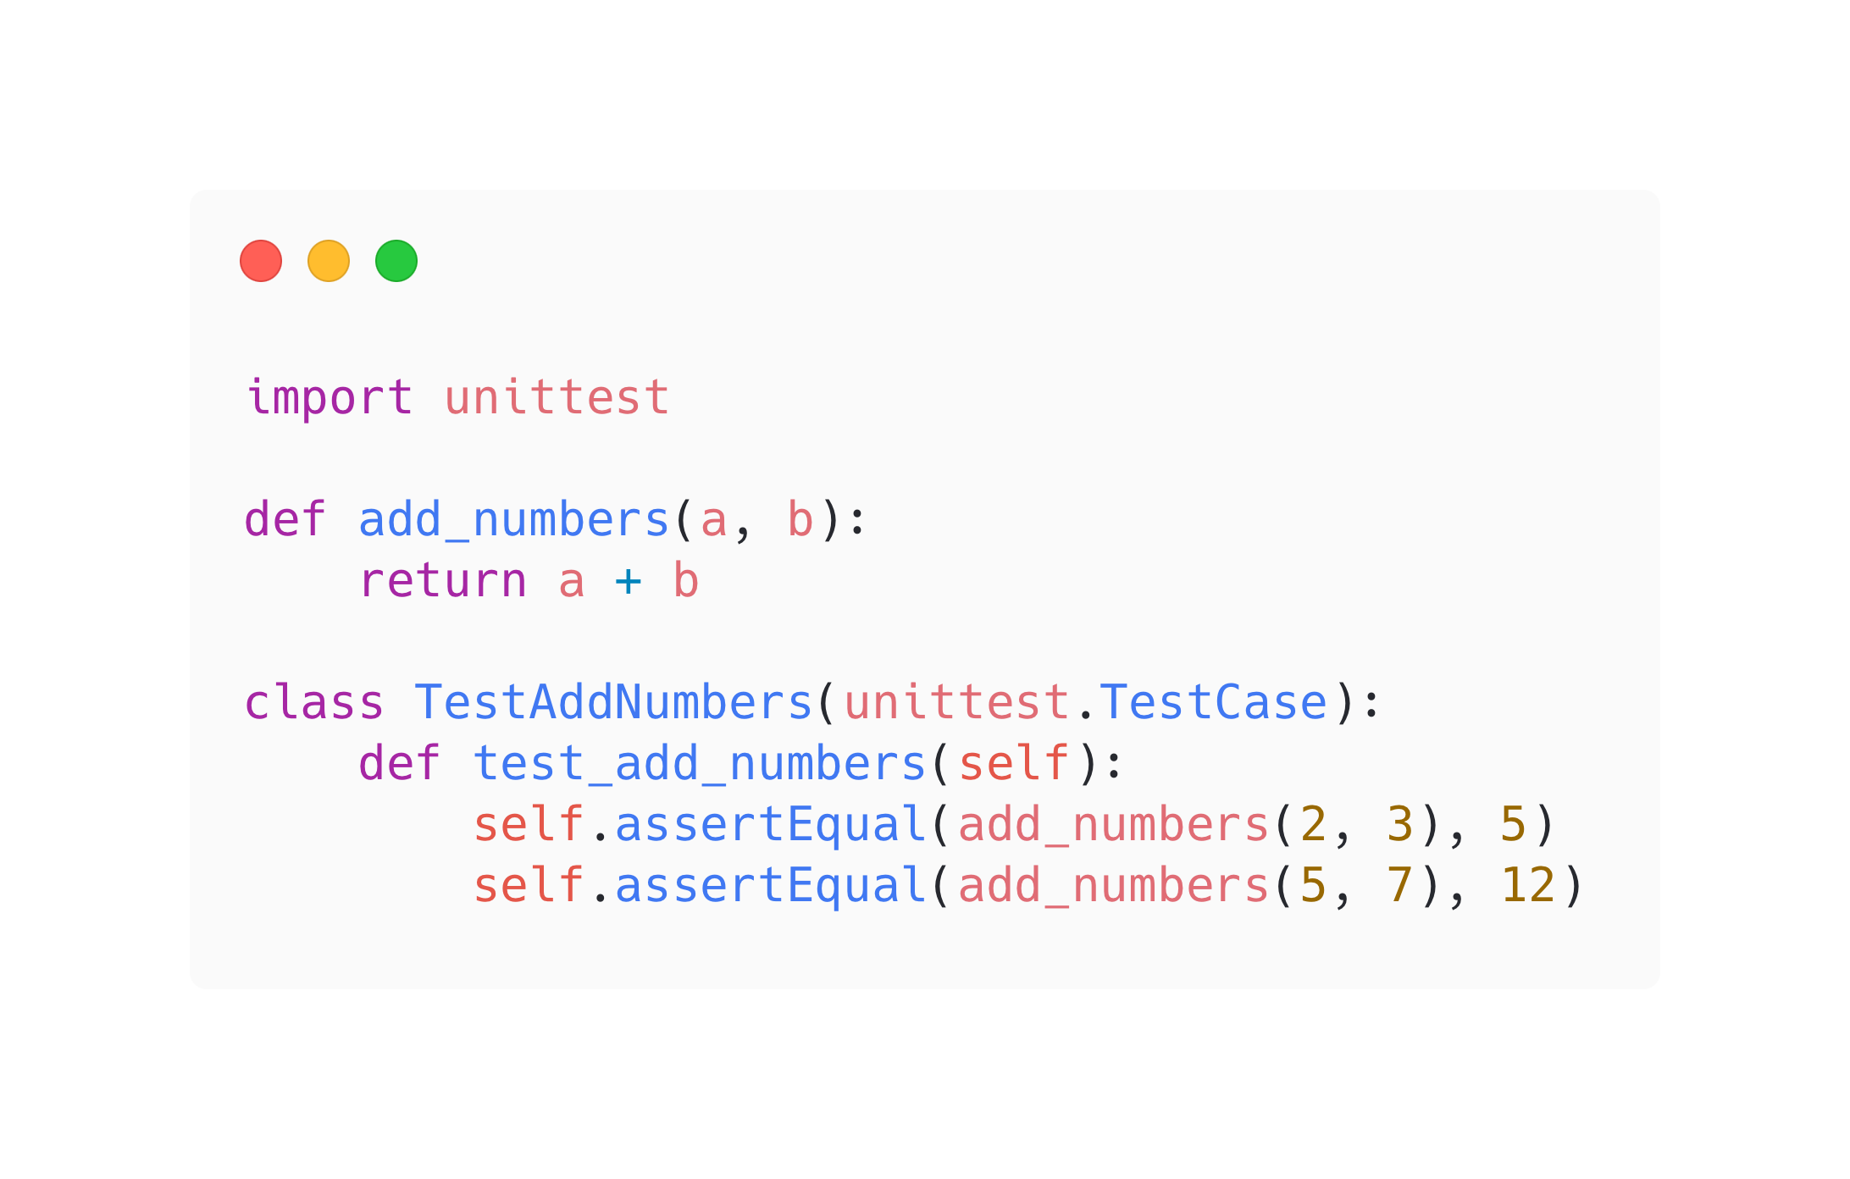
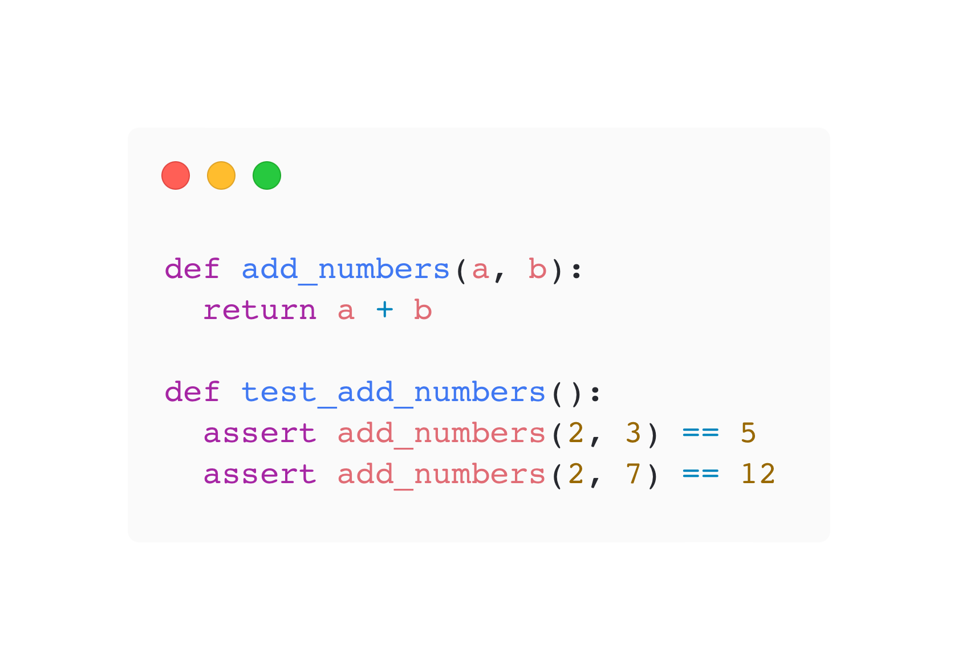
Comparison

Slide 6
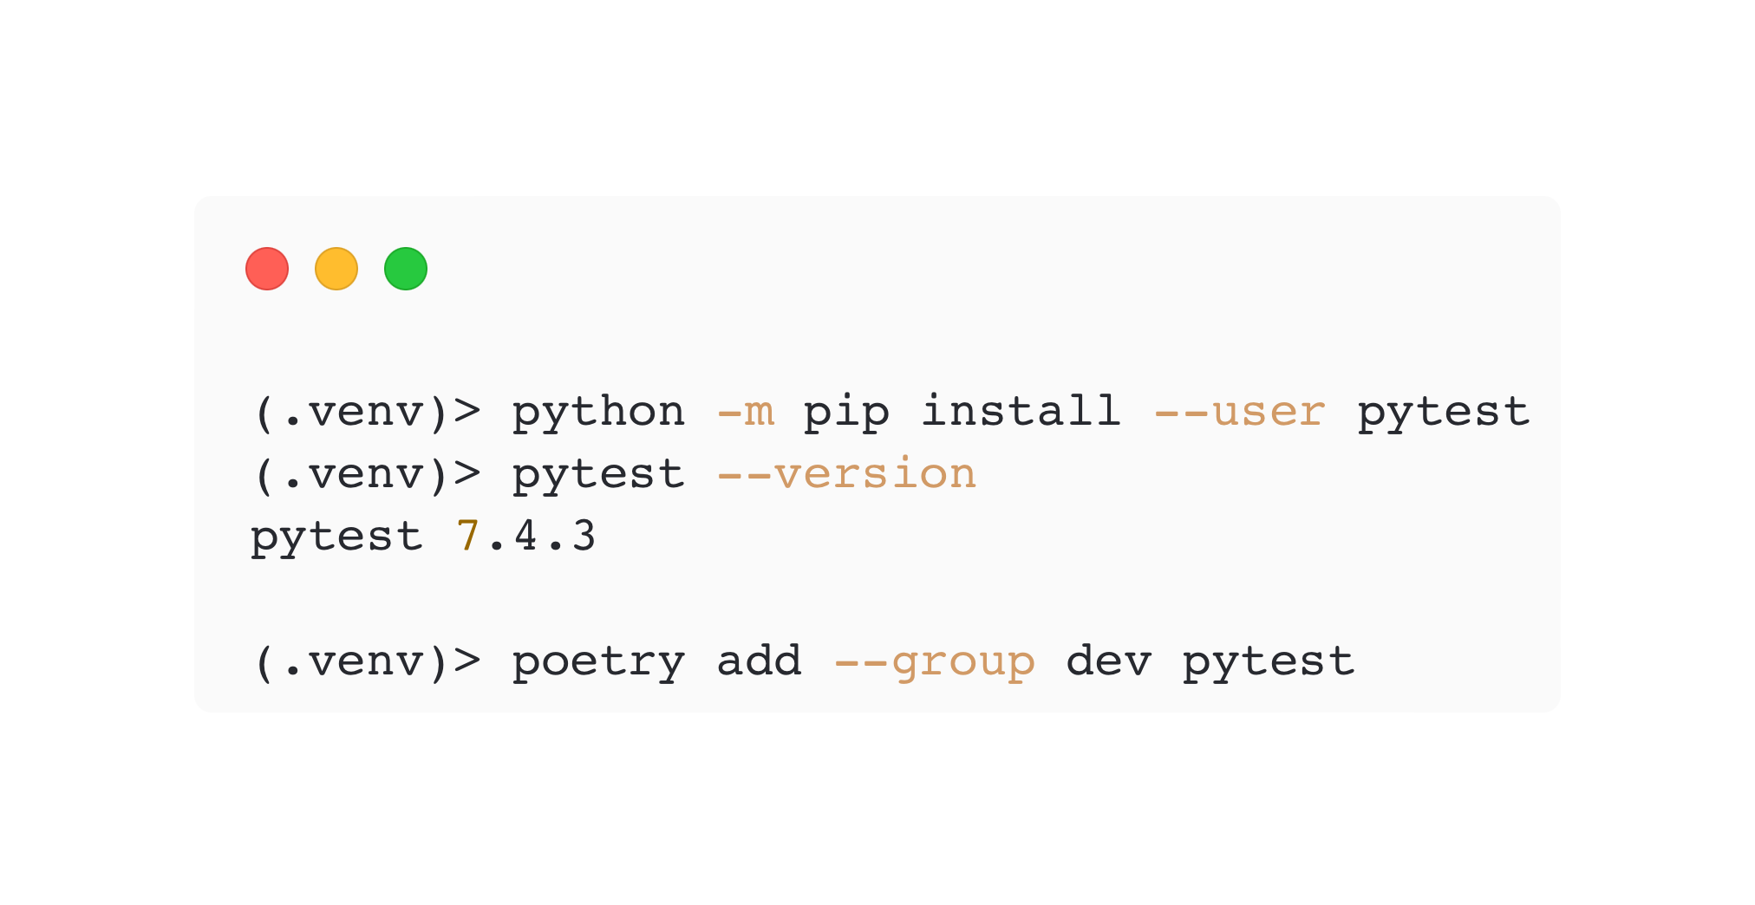
Install Pytest

Slide 7
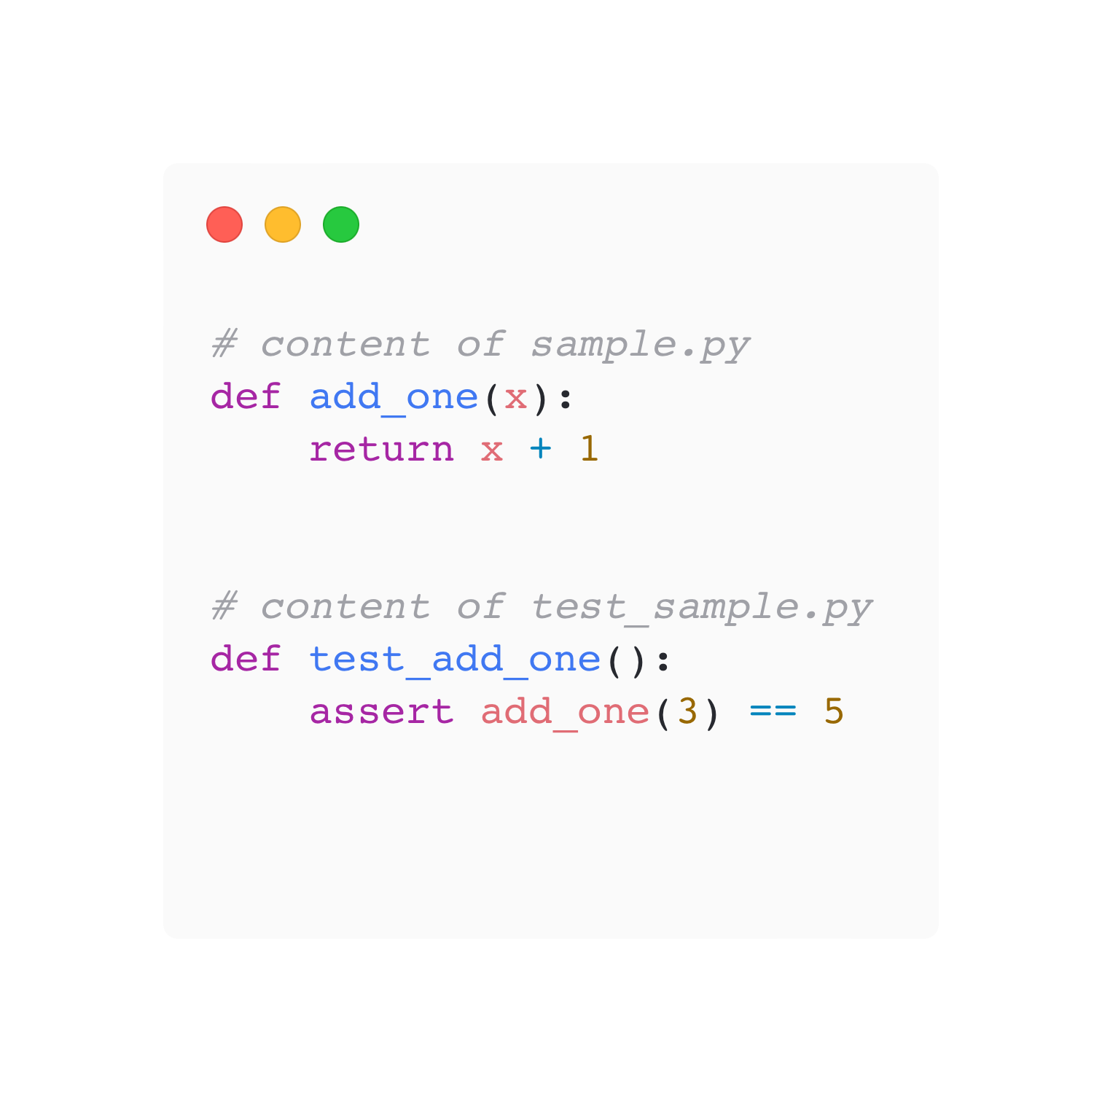
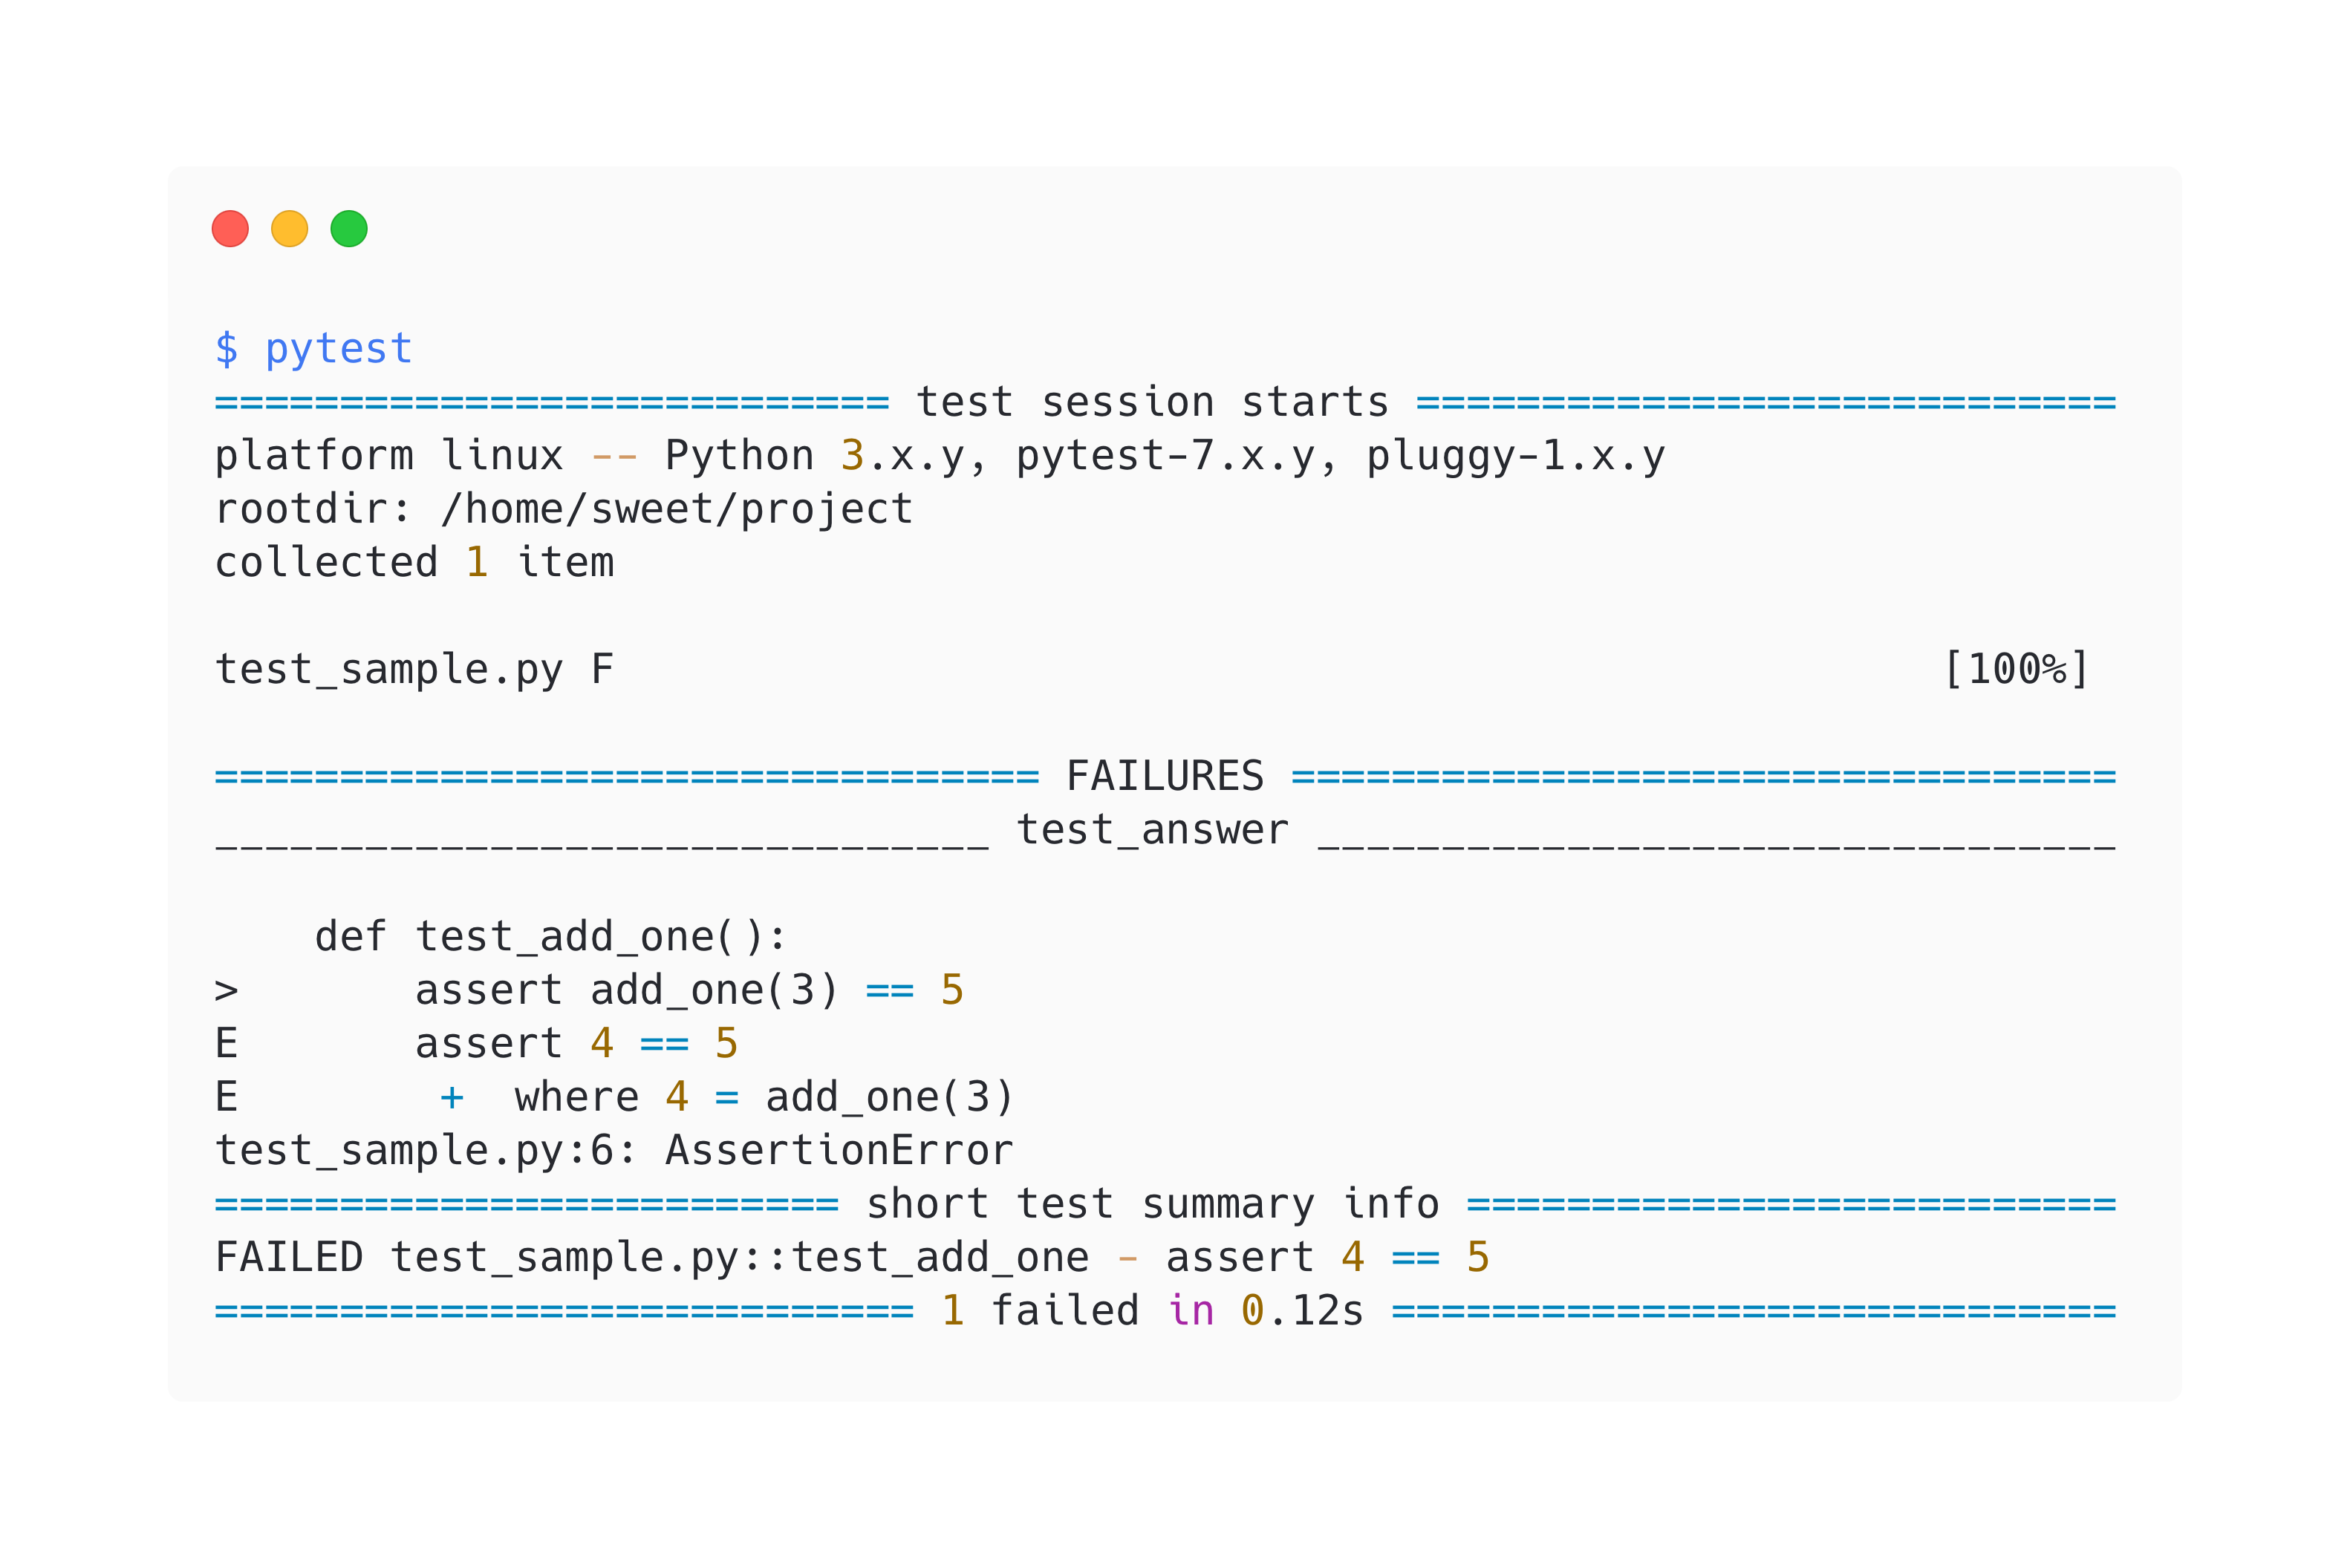
Basic Testing

Slide 8
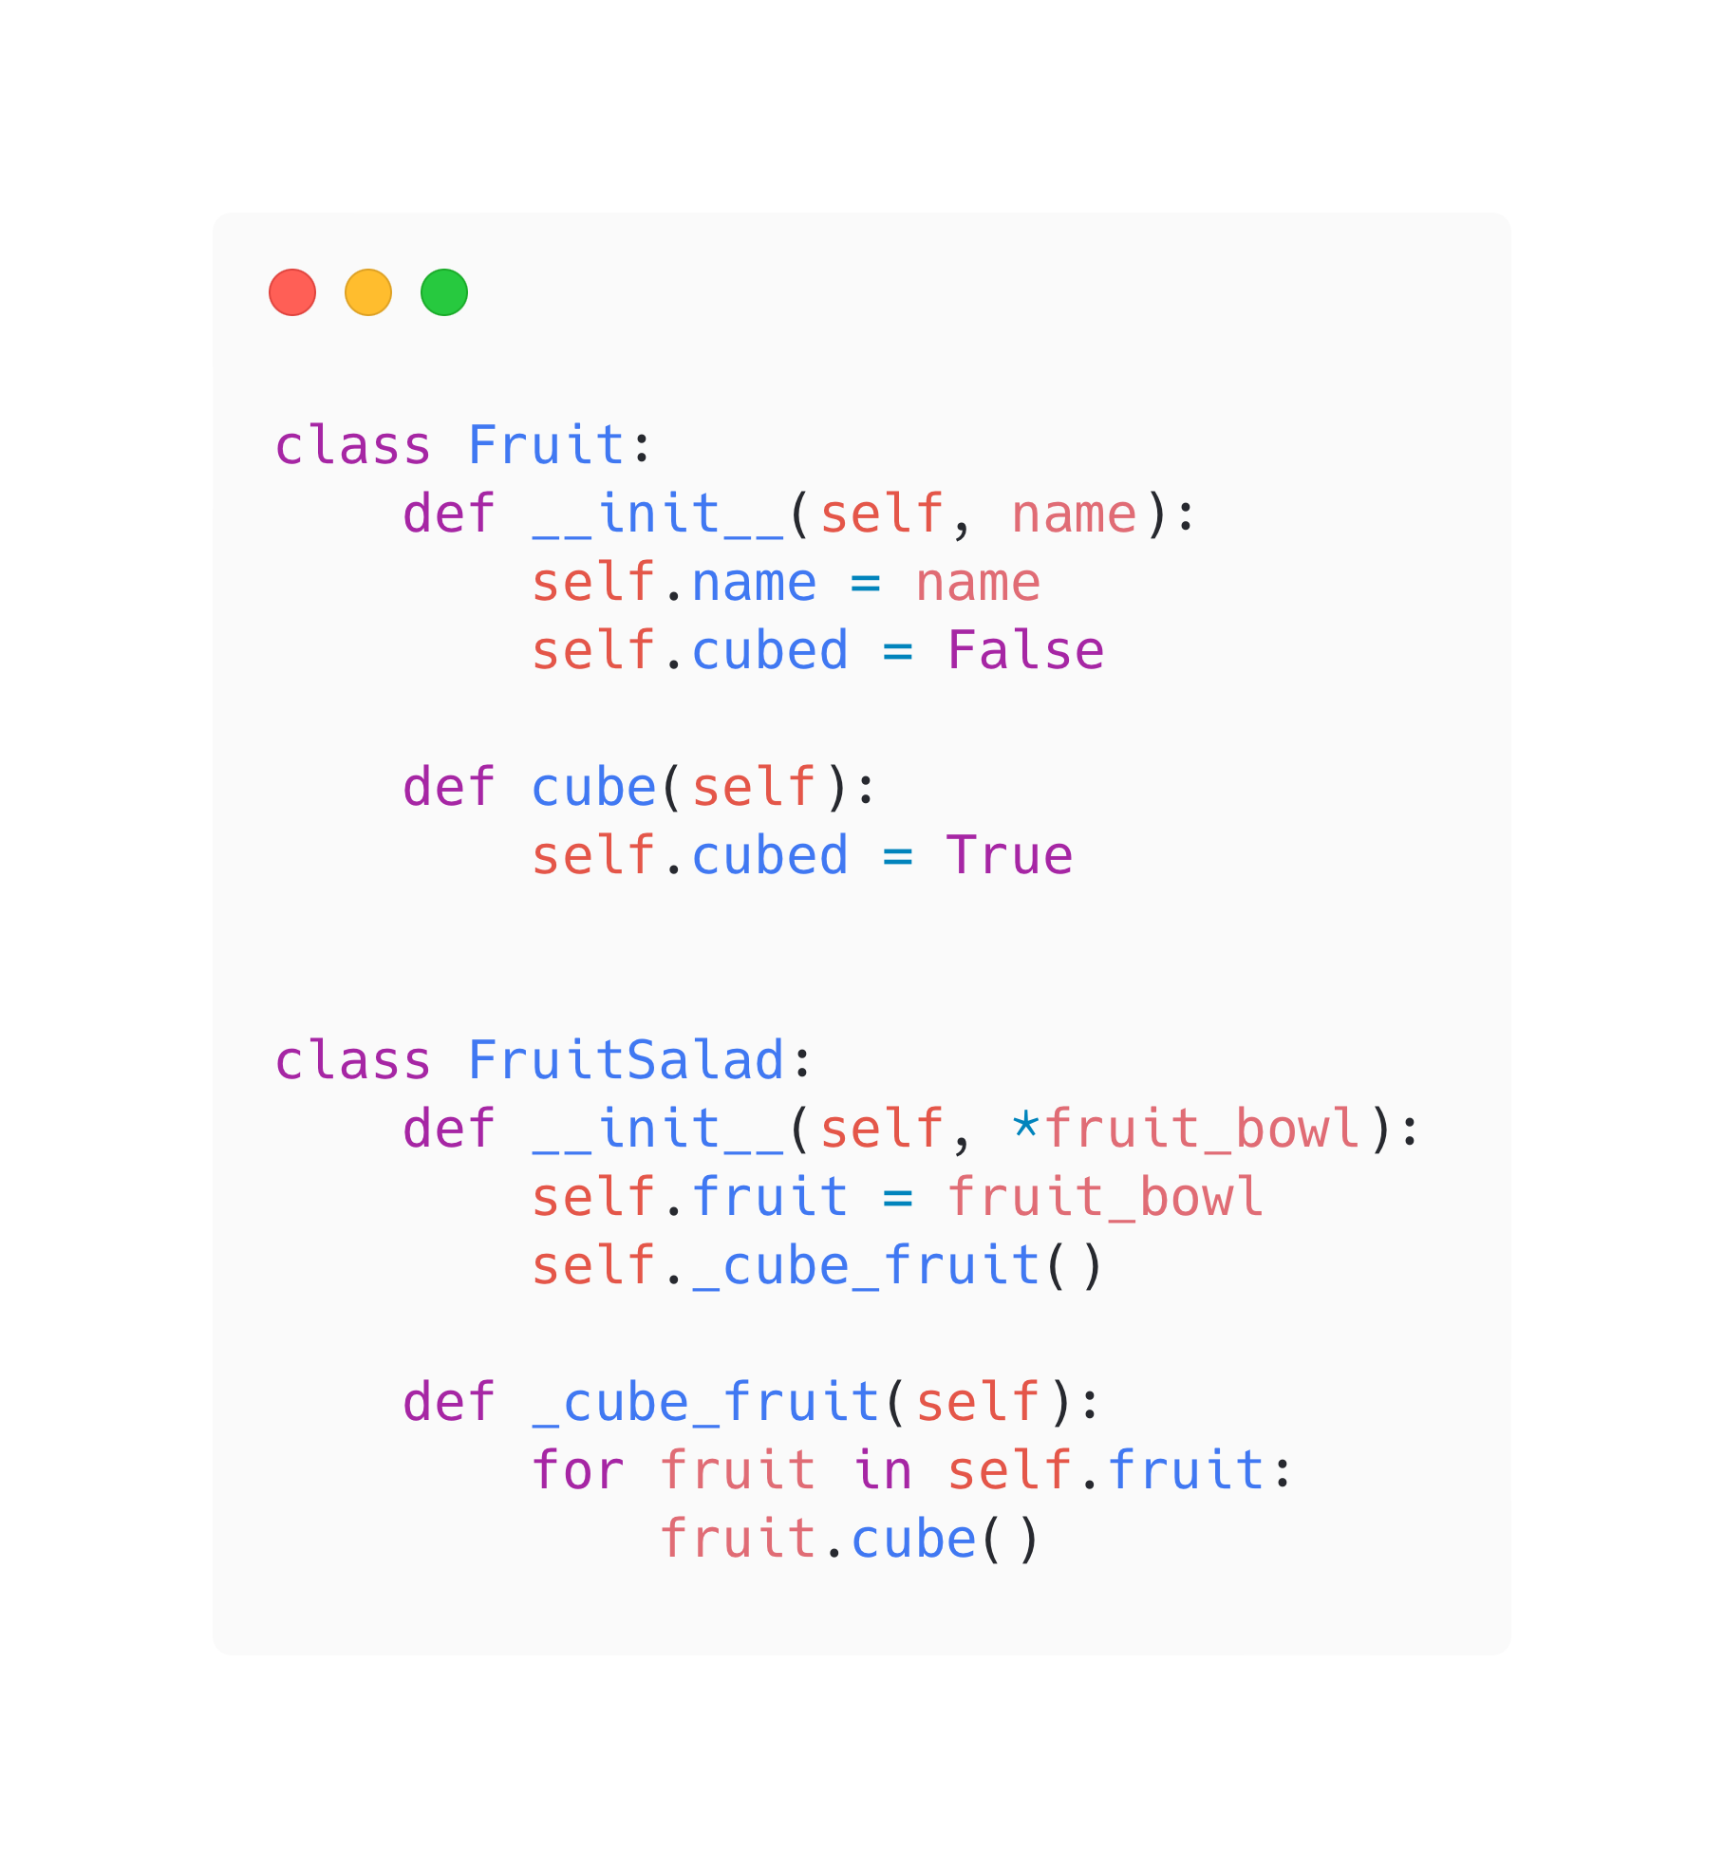
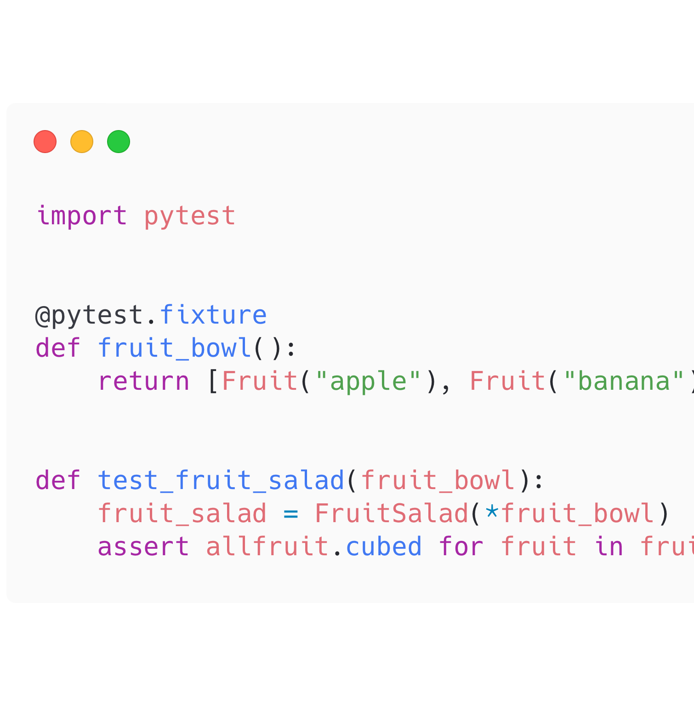
Pytest Fixtures

Slide 9
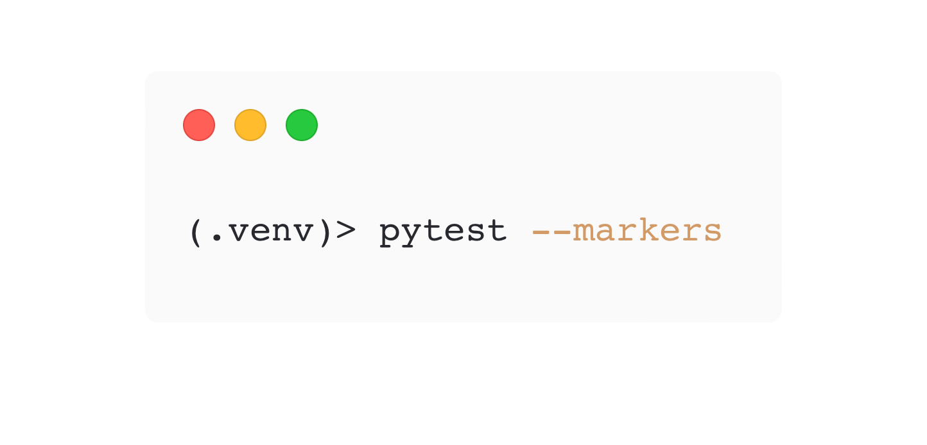
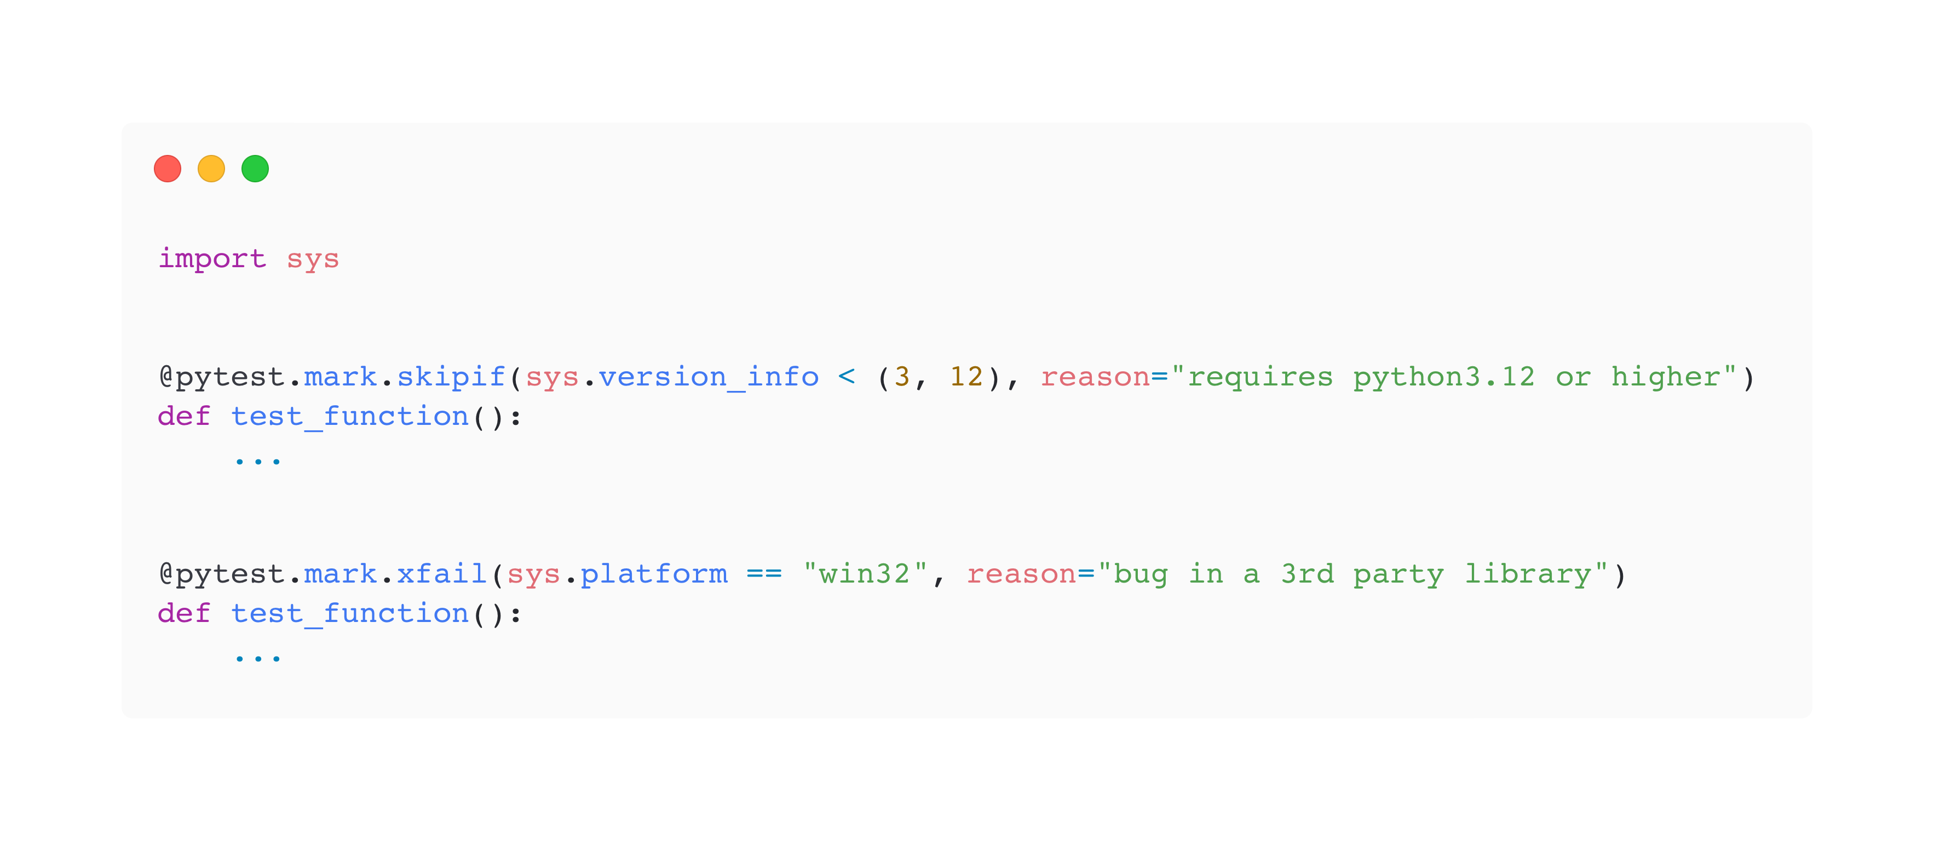
Mark Tests with Parameters

Slide 10
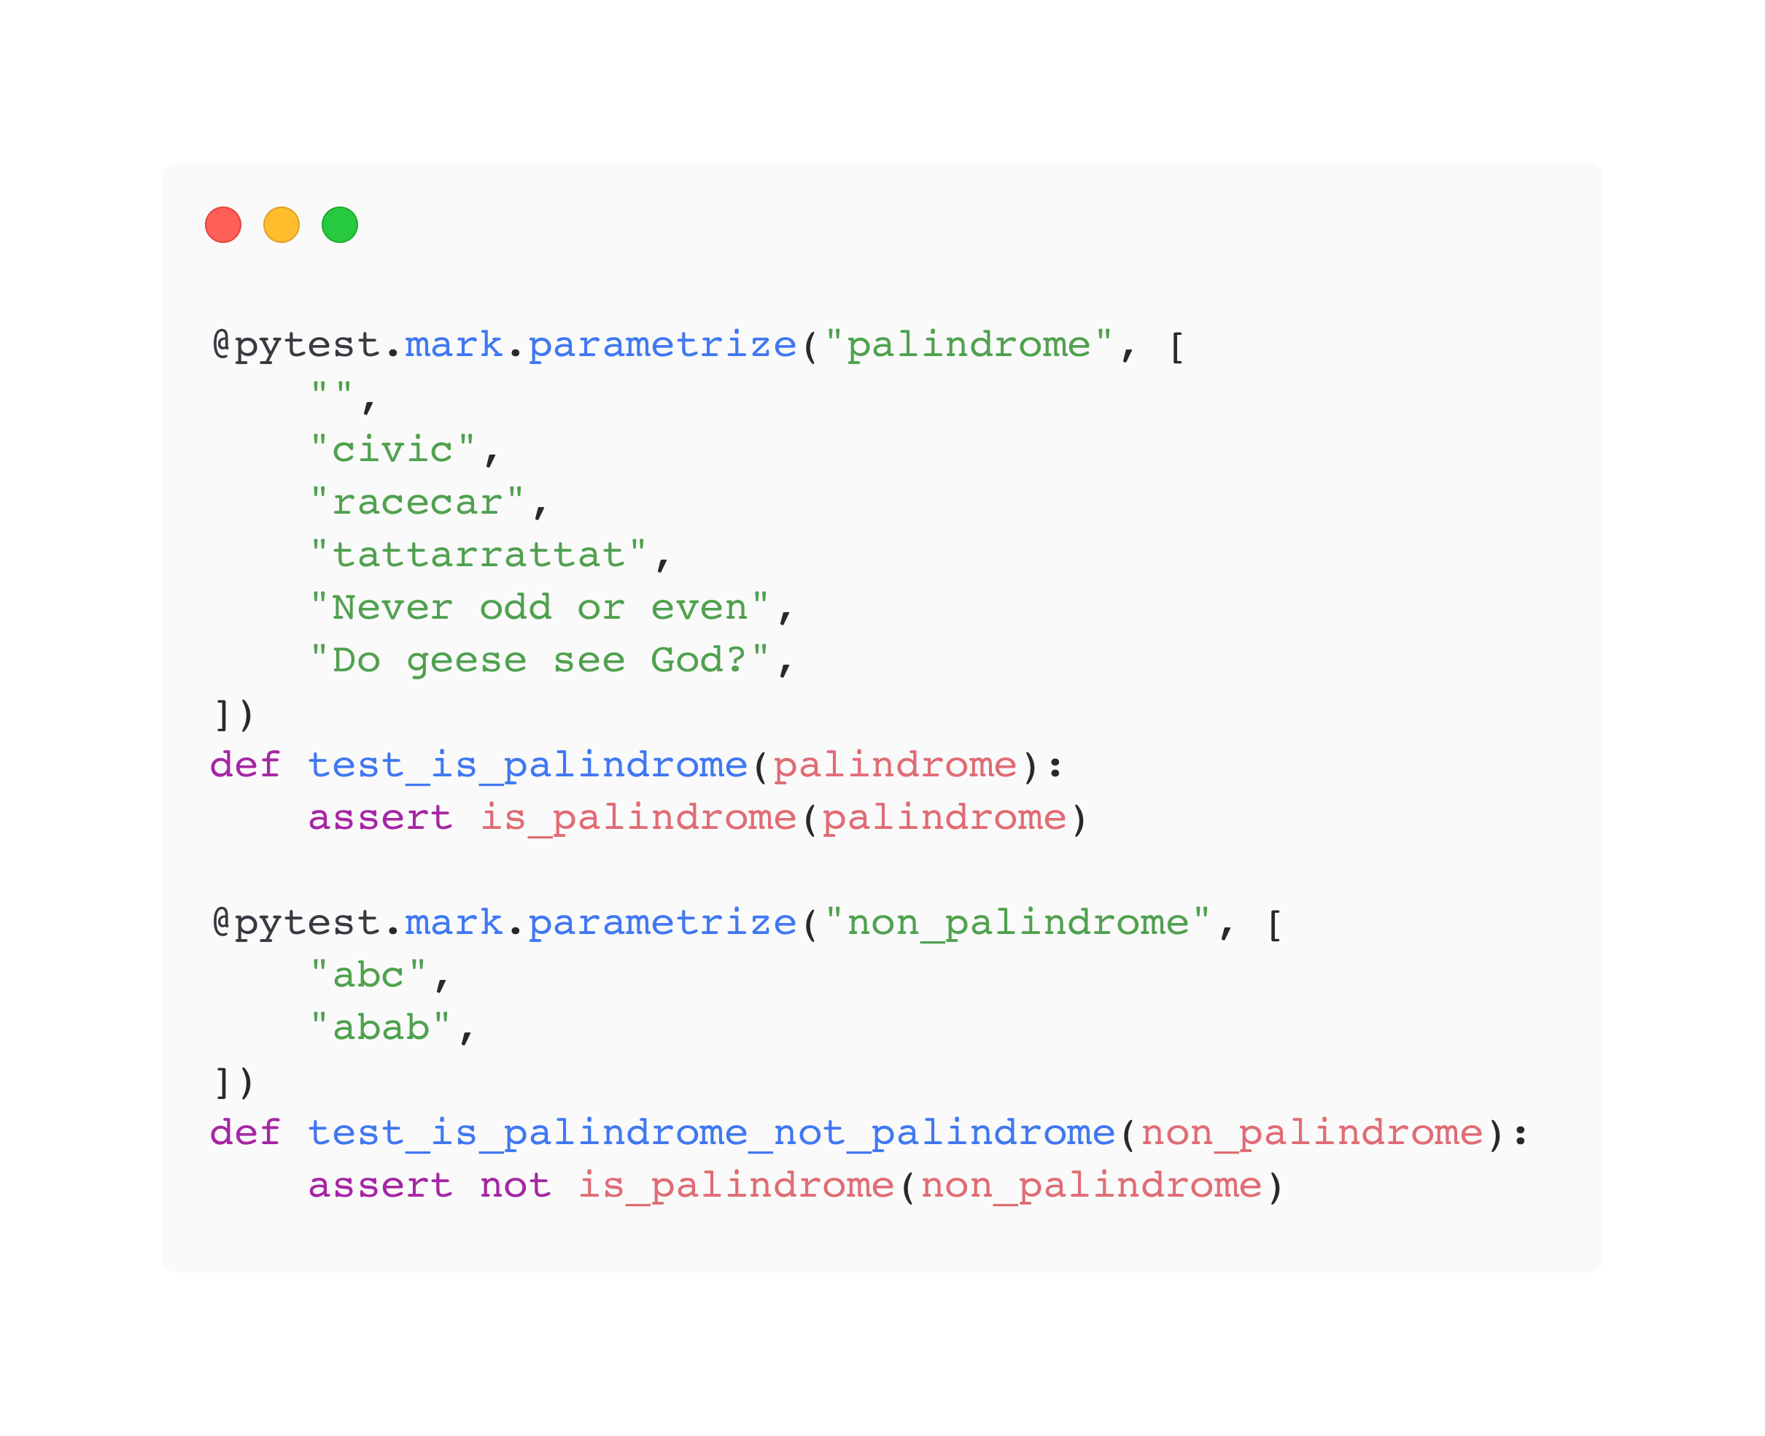
Parameterize Tests

Slide 11
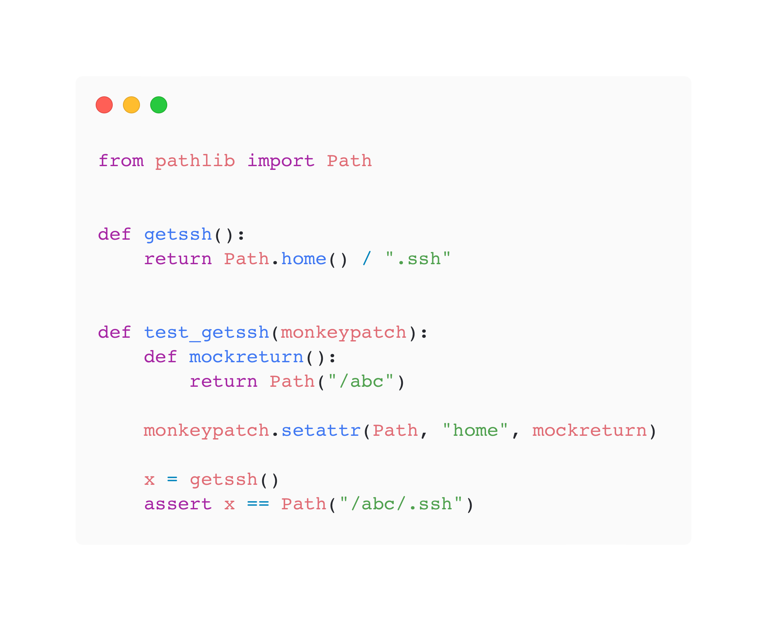
Monkeypatch and Mock
getssh()
Path.home
mockreturn
Path(“/abc”)

Slide 12

Plugins FTW!
Pytest has over 1000 plugins to extend and improve Pytest
pytest-xdist – Distribute testing across multiple CPU cores
pytest-randomly – Randomize test execution order
pytest-cov – Collect code coverage
pytest-archon – Define architectural rules
pytest-bdd – Behavior Driven Development

Slide 13
Password Generator ********
Write a generate_password() function that has a length parameter
The parameter is the length of the password
If length < 12, it is set to 12
The function returns a random password
At least 1 lowercase
At least 1 uppercase
At least 1 special character

Slide 14
Demo
Let’s Build It!

